Slide 1
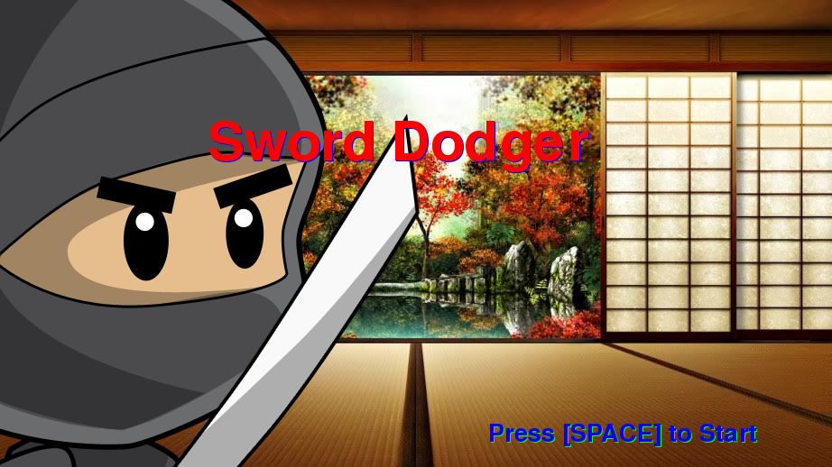
Notes:
Created By Carlos and Andrew
The name of our company is called A&C. A stands for Andrew and C stands for Carlos.

Slide 2
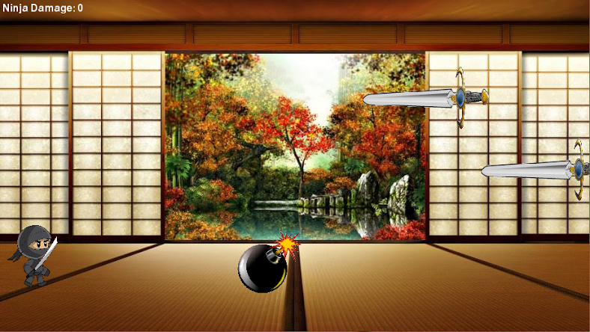
Notes:
The objective of this game is to dodge or jump over swords that are flying at you. There will be powerups that you will be able to collect that gives you an advantage. For example, speed boosts and adding additional health. The player will interact with the game by using the keyboard.

Slide 3
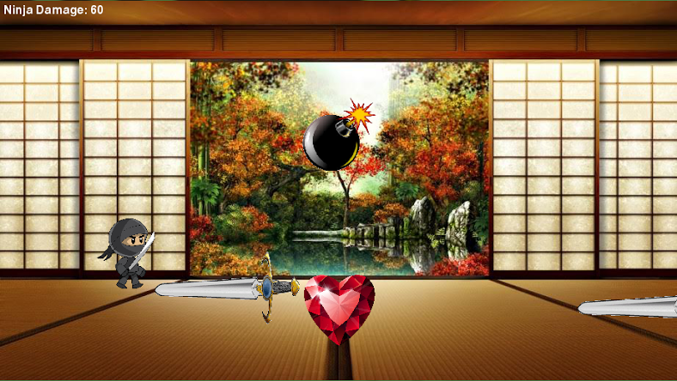
Notes:
The game that we have created is an endless arcade game. The player will be controlling a ninja who will be dodging swords. The swords will coming out of the side of the screen. While the game goes on there will be power-ups that generally makes the game easy. For example, adding additional health, bombs that will make u take more health than the swords . One of the challenges of this game is that to swords will be coming off of the side of the screen and your will have to dodge them.

Slide 4
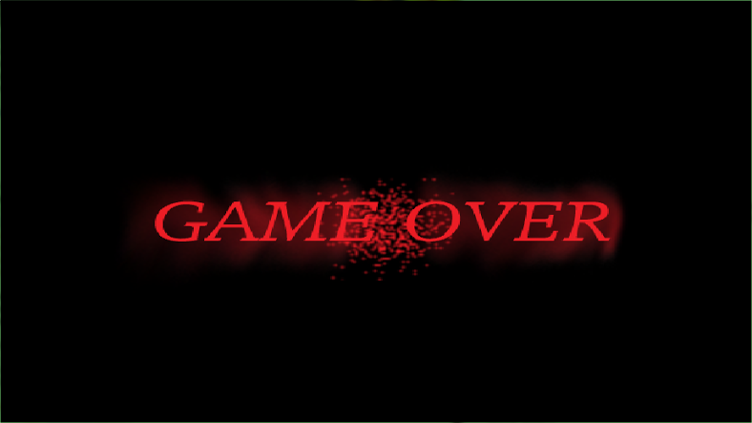
Notes:
You can’t win, you keep on playing until the ninjas damage reaches to 100.

